Slide 1

IDEOLOGY SHAPES THE WORLD
photo by Yasin Yusuf on Unsplash
GNED 500
WEEK4
Photo by Yasin Yusuf on Unsplash

Slide 2
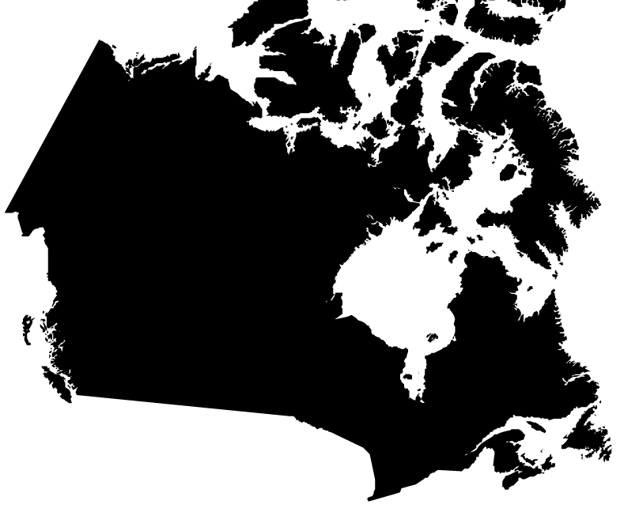
Acknowledgement
Traditional Lands
Canada Map Vectors by Vecteezy
Notes:
Acknowledgement of Traditional Lands
Centennial is proud to be a part of a rich history of education in this province and in this city.
We acknowledge that we are on the treaty lands and territory of the Mississauga’s of the Credit First Nation and pay tribute to their legacy and the legacy of all First Peoples of Canada, as we strengthen ties with the communities we serve and build the future through learning and through our graduates.
Today the traditional meeting place of Toronto is still home to many Indigenous People from across Turtle Island and we are grateful to have the opportunity to work in the communities that have grown in the treaty lands of the Mississauga’s.
We acknowledge that we are all treaty people and accept our responsibility to honor all our relations

Slide 3

AGENDA
UPDATE
REVIEW LAST CLASS
LEARNING OUTCOMES
IDEOLOGY METHODOLOGY
BELIEF SYSTEM
CONFIRAMTION BIAS
IDEOLOGY
ASSUMPTIONS
SOCIAL CONSTRUCT OF IDEOLOGY
HEGEMONY
DOMINANT IDEOLOGY
DOMINANT DISCOURSE
IDEOLOGICAL FRAMEWORK
COUNTER IDEOLOGIES
MOVEMENTS
Photo by Ann poan from Pexels
Notes:
UPDATE
REVIEW LAST CLASS
BELIEF
CONFIRAMTION BIAS
IDEOLOGY
ASSUMPTIONS
SOCIAL CONSTRUCT OF IDEOLOGY
DOMINANT IDEOLOGY
DOMINANT DISCOURSE
HEGEMONIC DISCOURSE
COUNTER IDEOLOGIES
MOVEMENTS

Slide 4

LEARNING OUTCOMES
At the end of this session, you will be able to:
Explain the concept of ideology and how various forms of Ideology differ
Determine how dominant ideologies socially construct our understanding of social problems.
Examine how counter ideologies challenge the assumptions embedded in dominant ideologies
Determine which ideologies shape your attitudes, values and behaviours in relation to social problems
Image created by macrovector - freepik.com
Notes:
The student will reliably demonstrate the ability to:
Reflect critically about one's role as a global citizen in personal and professional life.
Analyze the ways we come to understand the world, our perceptions of ourselves and others.
Critically analyze social issues considering different perspectives and historical roots.
Develop recommendations for a social action plan.

Slide 5

IDEOLOGY METHODOLOGY
Question and analyze assumptions.
Examine our Assumptions, attitudes and World Views
Our thoughts, talk, recognize certain issues as social problems
They also determine how we propose solutions
In order to find solutions we must consider ideology and discourse
Thoughts and discussions!
Backlog vector by storyset - freepik.com
Notes:
We mentioned the importance of examining our assumptions, attitudes, and worldviews.
The way we think and the way we talk about the many issues in society determine what we will come to recognize as social problems.
They also determine our proposed solutions to these problems.
To analyze how we think and speak of social problems, as well as the solutions we propose for these problems, we have to consider the roles of ideology and discourse.

Slide 6

BELIEF SYSTEM
We rely daily on ideas and values to form opinions, make assumptions, and arrive at conclusions.
Many of us aren’t aware of where these notions come from or how they influence our thinking.
Most of us assume that our points of view are accurate and truthful. We think that they are just common sense.
This often leads us to dismiss, discredit, or misinterpret perspectives that differ from our own (Paul & Elder, 2006).
Photo by Pixabay – Pexels.com
Notes:
We rely daily on ideas and values to form opinions, make assumptions, and arrive at conclusions.
Many of us aren’t aware of where these notions come from or how they influence our thinking.
Most of us assume that our points of view are accurate and truthful. We think that they are just common sense.
This often leads us to dismiss, discredit, or misinterpret perspectives that differ from our own (Paul & Elder, 2006).

Slide 7

Confirmation BIAS
We ignore facts that contradict our perspective or emphasize information favourable to our point of view.
This is Confirmation Bias!
That is the tendency to seek out perspectives that match our beliefs.
This means that we rarely evaluate our perspectives in relation to alternative points of view.
Confirmation BIAS
Photo by Jill Wellington – Pexels.com
Notes:
We ignore facts that contradict our perspective or emphasize information favourable to our point of view.
This is Confirmation Bias!
That is the tendency to seek out perspectives that match our beliefs.
This means that we rarely evaluate our perspectives in relation to alternative points of view.

Slide 8
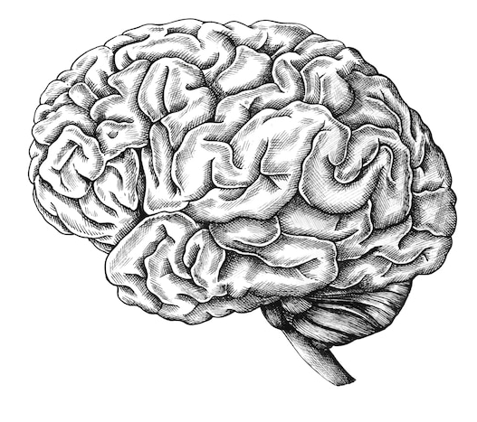
IDEOLOGY
Think about how our ideas, assumptions, and values are formed!
Root word “idea.”
A set of beliefs, ideas, and assumptions accepted as common sense.
World views that shape our perceptions and explanations of the world around us.
Ideologies can be
cultural, religions, political, legal, social, and/or ethical.
We absorb these particular ideologies through our immersion in social institutions
Image by rawpixel.com - freepik.com
Notes:
Think about how our ideas, assumptions, and values are formed and how they relate to power.
Ideology comes from the root word “idea.”
Ideologies refer to a set of beliefs, ideas, and assumptions that tend to be accepted as common sense.
They are the world views that shape our perceptions and explanations of the world around us.
Ideologies can be cultural, religions, political, legal, social, and/or ethical.
We absorb these particular ideologies through our immersion in social institutions like the family, religion, government, school, and the media.

Slide 9

EXAMPLES
Individualism: is an ideology that emphasizes self-sufficiency, freedoms, and the inherent worth of each individual.
Consumerism: is an ideology that encourages the purchase and consumption of goods as indicative of our worth.
Religion: are examples of ideologies.
Capitalism: products and services are best believed to be privately owned and operated for profit.
Socialism: believes that production, distribution, and exchange of goods and services should be under common ownership.
Racism: believes in essential differences and a natural hierarchy between different “races” of people.
Feminism perspectives based on advocating for the economic, social, and political equality between men and women.
Nationalism is the idea that our primary loyalty should be to the country in which we live in.
Vector by upklyak - freepik.com
Notes:
Individualism is an ideology that emphasizes self-sufficiency, freedoms, and the inherent worth of each individual.
Consumerism is an ideology that encourages the purchase and consumption of goods as indicative of our worth.
All religions are examples of ideologies. This does not mean that any particular religion is true or false, but that religions offer specific tenets of belief in a supreme power and an afterlife and offer us a code of conduct that shapes our perceptions and explanations of the world.
Capitalism is an ideology where products and services are best believed to be privately owned and operated for profit.
Socialism is an ideology that believes that production, distribution, and exchange of goods and services should be under common ownership.
Racism represents an ideology in that in believes in essential differences and a natural hierarchy between different “races” of people.
Heterosexism is a social ideology that advances heterosexuality as the normal and natural sexuality to the exclusion of all other forms of non-heterosexual identity.
The formation of the nation state of Canada is based on the ideology of imperialism, which is based on the idea that the imperial power is culturally, religiously and economically superior to all other nations or societies, which gives it the right to expropriate land and resources and control the destiny of indigenous populations.
Democratic racism is an ideology that permits two contradictory sets of values to coexist. One set of values embraces liberal ideas of fairness, justice and equality, and the other set permits attitudes and behaviours that are racist.
Feminism encompasses a range of ideological perspectives based on advocating for the economic, social, and political equality between men and women.
Nationalism is the idea that our primary loyalty should be to the country in which we live in.

Slide 10

QUESTION
What ideologies do you subscribe to?
Where did these ideologies come from?
We simply absorb them through our participation in various social institutions.
Our participation in these systems becomes the norm and the dominant ideology
Photo by Pixabay – Pexels.com
Notes:
Brands and media have a major effect on our ideologies.
Question:
What ideologies do you subscribe to?
Where did these ideologies come from?
These are just a few examples of the many types of ideologies that exist in different societies.
Again, it is important to realize that we often do not realize that our ideas and beliefs correspond to a particular ideology.
We simply absorb them through our participation in various social institutions.
This brings us to a consideration of dominant ideologies.

Slide 11
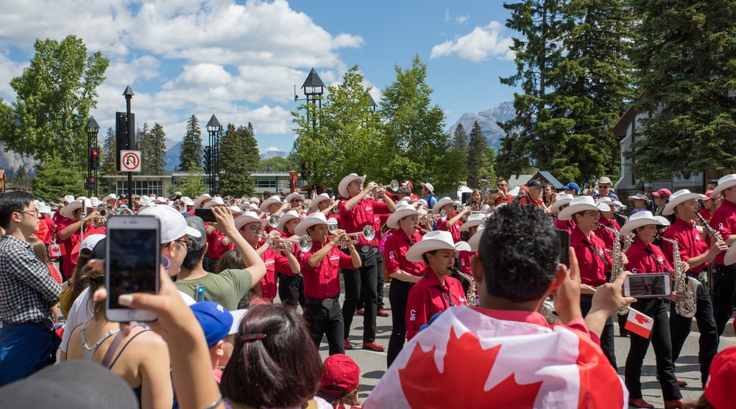
ASSUMPTIONS
Imagine that you are sitting with a friend in the college cafeteria and your friend identifies a classmate in the Tim Horton’s line-up as the ‘Canadian guy.’
Describe what you are thinking of what the person looks like?
WHAT ASSUMPTIONS ARE YOU MAKING?
Photo by Andy Holmes on Unsplash
Notes:
Describe what you are thinking of who and what that person looks like!
Where does this assumption come from?
What assumptions might you make?

Slide 12
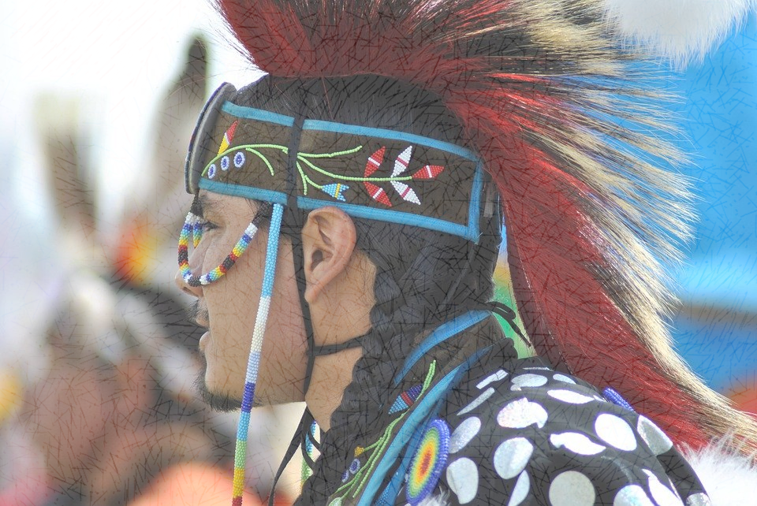
TO BE CANADIAN
Image by Laura Hamilton from Pixabay
Notes:
You may have learned that First Nations people were the original inhabitants of Canada and have been for thousands of years.
Do you think this image represents a Canadian?
What about the contribution of Black people to Canada?
In spite of this knowledge, you would probably look out for a white Canadian.

Slide 13
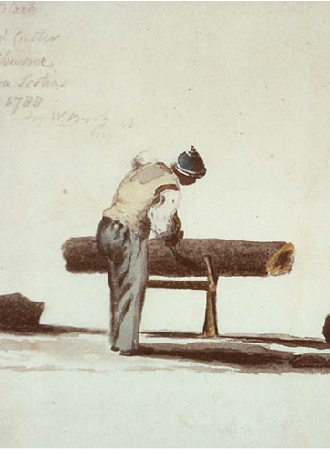
BLACK LOYALISTS
3,000 African American supporters of the British during the American Revolution
Repatriated to British Canada at the end of the conflict.
Most settled in Nova Scotia
Established what would be for decades, the largest concentration of black residents in Canada
Largest settlement of free black people outside of Africa.
Black Nova Scotians (By Captain William Booth, 1788 [Public domain], via Wikimedia Commons)
Notes:
The Black Loyalists were the approximately 3,000 African American supporters of the British during the American Revolution who were repatriated to British Canada at the end of the conflict. Most settled in Nova Scotia and established what would be for decades, the largest concentration of black residents in Canada and what was at the time the largest settlement of free blacks outside Africa.
The Black Loyalists who fought for Great Britain believed they were fighting not only for their own freedom, but for the ultimate abolition of slavery in North America. The British commitment to the these loyalists began when Virginia's Royal Governor, Lord Dunmore, issued a proclamation promising freedom to all Virginia slaves who supported the British and the white Loyalist allies.
Over the seven years of the American Revolution these men made an immense contribution to the British war effort. The black pioneers were the most famous of the Black Loyalist military units. A pioneer was a soldier whose main task was to provide engineering duties in camp and combat. Divided into a number of different corps attached to larger armies, they served as scouts, raiders, and what we would call today military engineers. While generally not a fighting unit, they would have often been called to work under heavy fire and the most dangerous conditions.
As the British began preparations for their withdrawal from the American colonies at the end of the Revolutionary War in 1783, they sought land on which to settle the white and Black Loyalists who were displaced by the war. Their search led them to the largely unoccupied, unsettled province of Nova Scotia in Canada.
The first Black Loyalists—men, their wives and children--arrived in Halifax and other Maritime ports in the summer of 1783. Since they had fought for the British Crown and were promised the same rights, privileges and freedom that their white counterparts were to receive, they expected land and to be incorporated into the provincial political structure. They were, however, betrayed by the colonial government which initially provided neither land or respected their political or civil rights. Some British Army officers suggested the Black Loyalists be used as ransom for the British prisoners still held by the Americans. Civilian Loyalists, including many slaveholders from the thirteen colonies, argued that the blacks should be re-enslaved.
During this period of vulnerability, the black migrants became the source of cheap labour for the more prosperous Nova Scotians, often scrambling to survive by any means available to them. Black Loyalists, however, pressured the colonial government of Nova Scotia to honour its commitment to them. Many held certificates signed by British General Samuel Birch, guaranteeing their freedom, and a promise that a small plot of land would be waiting for them.
In September 1783, the colonial government finally provided land. Seven companies of black pioneers were led by their black commander, Colonel Stephen Blucke to the new settlement, which they named Birchtown in honour of General Samuel Birch. These settlers became known as the Birchtown Black Loyalists. Birchtown soon became the destination of choice for many isolated communities of blacks and refugees. The population ranged from 1,500 to 2,000 people, more than half of the Black Loyalists in Nova Scotia.
Birchtown, however, soon proved unsuitable. The community was situated on the rocky side of the Halifax harbour, and was virtually surrounded by a large swamp. The available farmland was mostly rocky barren soil. The Black Loyalists were left to work this area for nearly a decade with virtually no livestock, guns or ammunition for hunting, lumber for housing or capital or credit for supplies. Ultimately these liabilities took its toll on the settlers.
In 1791, Thomas Peters, a Pioneer sergeant, journeyed to London to lodge a formal complaint about the injustices black settlers were suffering in Nova Scotia. While in London, Peters met with the chairman of the Sierra Leone Company and was able to negotiate the free passage of approximately 1,200 black Nova Scotian residents to the west coast of Africa, where they would help establish a free black colony. Consequentially, Birchtown was mostly depopulated by 1792 as nearly all of the people who had a choice left for Africa. Colonel Stephen Blucke and about 50 families remained but most of them gradually moved away over the years to Halifax and other cities.
Today most of Birchtown's residents are white. Nonetheless it is the home of the Black Loyalist Society. There is a National Heritage Monument on the site of the original Birchtown cemetery and a small museum in a 19th Century school.
- blackpast.org
Black Nova Scotians
The earliest known image of a Black Nova Scotian, in British Canada, in 1788. He was a wood cutter in Shelburne, Province of Nova Scotia
(by Captain William Booth, 1788 [Public domain], via Wikimedia Commons)

Slide 14
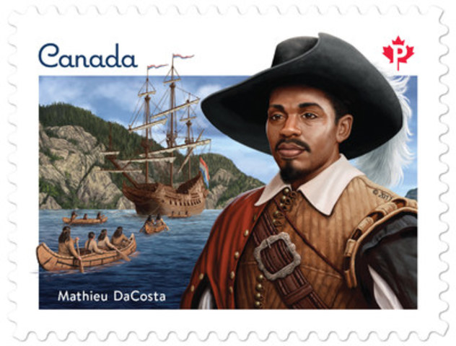
Mathieu Da Costa
African interpreter, worked as a free man, for the French & Dutch in the early 1600’s
Spoke French, Dutch Portuguese and Pidgin.
Was able to communicate with Indigenous People
He lived in Port Royal (Nova Scotia) for a short time
Mathieu Da Costa
Andrew Perro and Ron Dollekamp, Canada Post, 2017
(CNW Group/Canada Post)
Notes:
Mathieu Da Costa (depending on the language of the documents that mention his name, also known as “Mateus Da Costa,” “Mathieu de Coste,” “Matheus de Cost” and “een Swart genamd Matheu”), interpreter (dates and places of birth and death unknown). Da Costa is one of the most fascinating and elusive figures in the early history of Canada. Historians consider him the first Black person known to have visited Canada, probably in the company of Pierre Dugua de Mons and Samuel de Champlain. But many aspects of his life remain unclear or unknown.
What is less clear, however, is how Da Costa ended up working as an interpreter for Indigenous peoples in North America. Historians think that he may have used a Basque “pidgin” language (a fusion between Basque and the local Indigenous languages) commonly employed in trading along the Atlantic coast of North America, where the Basques of northern Spain frequently came to fish. Many European voyagers, such as Marc Lescarbot, mention the existence of such pidgin languages in the early 1600s. The Mi’kmaq and the Innu, who lived on the north shore of the St. Lawrence River, understood this dialect. It is also possible that Da Costa made some extended stays in the Americas and learned one or more Indigenous languages in the process — or even that he met North American Indigenous people in Europe and became familiar with some aspects of their languages.
Canadian Encyclopedia

Slide 15

SOCIAL CONSTRUCTION OF Ideologies
History is often told from the point of view from the dominant culture in society
We often see the history and stories of European people and the institutions that they have established.
This history makes little if no mention at all to references of First Nations People and or Black People in Canada.
This frames Canada as a white European nation and many institutions reinforce this ideology such as the Canadian government, schools, mass media, and other forms of popular culture.
It has been reinforced to the point that even when we know better, we unconsciously think of a Canadian as having European ancestry.
Stock photo by Vecteezy
Notes:
Dominant ideologies usually reflect the interests of those in power – those who have more influence and control over the social institutions that spread these ideas.
As a result, many of us adopt dominant perspectives on social issues without even being aware that we are subscribing to a particular ideology.
They just seem like common sense.
This is because we have learned to talk and think about these issues in a particular way – through discourse.

Slide 16

BREAK OUT SESSION
Photo by Jopwell from Pexels.com
Notes:
Discuss in a group what it means to be CANADIAN!
What are some of the assumptions that you hold on what being Canadian is?
What ideas, values and interests are being promoted by the dominant discourse of who is regarded as a Canadian?

Slide 17

BREAK
Photo by Pixabay from Pexels
Notes:
15 Minute Break
This slide can be moved to where you have your class break(s)

Slide 18


ATTENDANCE
ATTENDANCE MATTERS
Image by pch.vector - freepik.com
Notes:
This attendance slide can be moved to wherever in your class that you take attendance.
Usually attendance is taken around class breaks, or at the beginning or at the end of class.

Slide 19

HEGEMONY
You may have noticed that many of us support ideologies that do not best serve our interests. Why is that?
Powerful groups have ways to encourage society to believe in ideologies that protect their interests.
This process of getting people to accept the interests and values of ruling groups without force is called hegemony
Therefore, Hegemony can also be defined as rule by consent.
Okay photos by Cookie Studio - freepik.com
Notes:
Dominant discourses can be found in propaganda, cultural messages, and mass media.
For example, in Canada, the dominant discourse that capitalism is the best economic system can be found in media, schools, and popular culture.
It is promoted in business schools and publications and no other options are usually even mentioned.
This narrows how we talk and think about economics. We disregard alternatives and accept the ideology that capitalism is the most democratic, fair, and effective way to organize the economy.
Dominant discourses tend to hide negative realities.

Slide 20

Dominant Ideologies
All ideologies exist in relation to each other.
Different ideologies compete to establish their vision for society
But certain ideologies resonate more strongly because they are reinforced through social institutions. We come to call these dominant ideologies.
For example, capitalism is a dominant ideology in North America.
Dictator created by macrovector - freepik.com
Notes:
All ideologies exist in relation to each other.
Different ideologies compete to establish their vision of the best ways to organize society – including the best ways to understand and address social problems.
But certain ideologies resonate more strongly because they are reinforced through social institutions. We come to call these dominant ideologies.
For example, capitalism is a dominant ideology in North America. Even though we may debate the nature and private ownership and profit, very few question its place as the best economic system available.

Slide 21

Dominant Ideologies
For example, capitalism is a dominant ideology in North America. Even though we may debate the nature and private ownership and profit, very few question its place as the best economic system available.
Where as socialism is a dominant ideology in the East i.e. China whereby the social construct of oneness is dominant
Dictator created by macrovector - freepik.com
Notes:
For example, capitalism is a dominant ideology in North America. Even though we may debate the nature and private ownership and profit, very few question its place as the best economic system available.
Where as socialism is a dominant ideology in the East i.e. China whereby the social construct of oneness is dominant

Slide 22

Dominant Ideologies
Dominant ideologies usually reflect the interests of those in power.
As a result, many of us adopt dominant perspectives on social issues without even being aware.
They just seem like common sense to us.
We have learned to talk and think about these issues in a particular way – through discourse.
Dictator created by macrovector - freepik.com
Notes:
Dominant ideologies usually reflect the interests of those in power – those who have more influence and control over the social institutions that spread these ideas.
As a result, many of us adopt dominant perspectives on social issues without even being aware that we are subscribing to a particular ideology.
They just seem like common sense.
This is because we have learned to talk and think about these issues in a particular way – through discourse.

Slide 23















DISCOURSE
Ideologies are shaped through discourse
Discourse refers to a way of talking and thinking about a particular topic or subject.
Different occupations and professions will have their own discourses
E.g. Students in IT, for example, will have a specialized vocabulary as will students in engineering, nursing, and robotics.
Artwork by Hi Profile is licensed under a CC BY-NC-SA 4.0 International License.
Notes:
Ideologies are shaped through discourse
Discourse refers to a way of talking and thinking about a particular topic or subject.
Different occupations and professions will have their own discourses – i.e., their own vocabulary and way of thinking about particular issues.
Students in IT, for example, will have a specialized vocabulary as will students in engineering, nursing, and robotics.

Slide 24

DOMINANT DISCOURSE
Dominant discourses can be found in propaganda, cultural messages, and mass media.
For example, in Canada, the dominant discourse that capitalism is the best economic system can be found in media, schools, and popular culture.
It is promoted in business schools and publications and no other options are usually even mentioned.
This narrows how we talk and think about economics. We disregard alternatives and accept the ideology that capitalism is the most democratic, fair, and effective way to organize the economy.
Image by rawpixel.com
Notes:
Dominant discourses can be found in propaganda, cultural messages, and mass media.
For example, in Canada, the dominant discourse that capitalism is the best economic system can be found in media, schools, and popular culture.
It is promoted in business schools and publications and no other options are usually even mentioned.
This narrows how we talk and think about economics. We disregard alternatives and accept the ideology that capitalism is the most democratic, fair, and effective way to organize the economy.
Dominant discourses tend to hide negative realities.

Slide 25
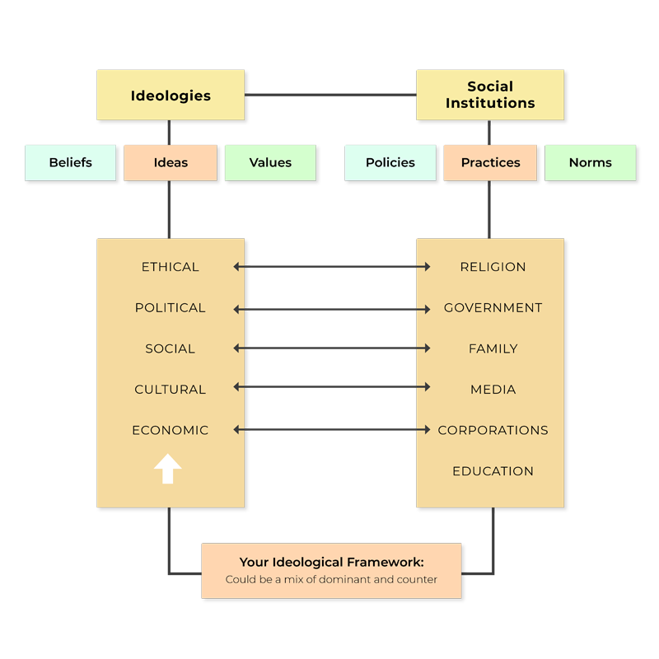
IDEOLOGICAL FRAMEWORK
Your beliefs, ideas, and values make up your ideological framework.
This framework is developed over a lifetime of socialization.
Interactions with and within social institutions create your ideology.
These institutions transmit dominant ideologies
They do this through policies, practices, and norms.
The ideas of dominant groups operate hegemonically through the creation of common-sense assumptions shared by everyone.
“How Agents of Socialization Shape Your Ideological Framework” by Chet Singh, Centennial College is licensed under a CC BY-NC-SA 4.0 International License.
Notes:
IDEOLOGICAL FRAMEWORK
Your beliefs, ideas, and values make up your ideological framework.
This framework is developed over a lifetime of socialization.
Interactions with and within social institutions create your ideology.
Social institutions include the family, education systems, mass media, and religious institutions.
These institutions transmit dominant ideologies to us.
They do this through policies, practices, and norms. In this way, the ruling ideas of dominant groups operate hegemonically through the creation of common-sense assumptions shared by everyone.

Slide 26

COUNTER IDEOLOGIES
Generally, counter ideologies, and the counter discourses associated with them, articulate an
“alternative set of values and assumptions that are more inclusive, equitable, just, and less harmful.”
Graphic by macrovector - www.freepik.com
Notes:
Generally, counter ideologies, and the counter discourses associated with them, articulate an alternative set of values and assumptions that are more inclusive, equitable, just, and less harmful.
Counter ideologies question the “common-sense” ideas of dominant ideologies and dominant discourses. They draw attention to how dominant ideologies justify injustice and lead to inequality and discrimination.

Slide 27
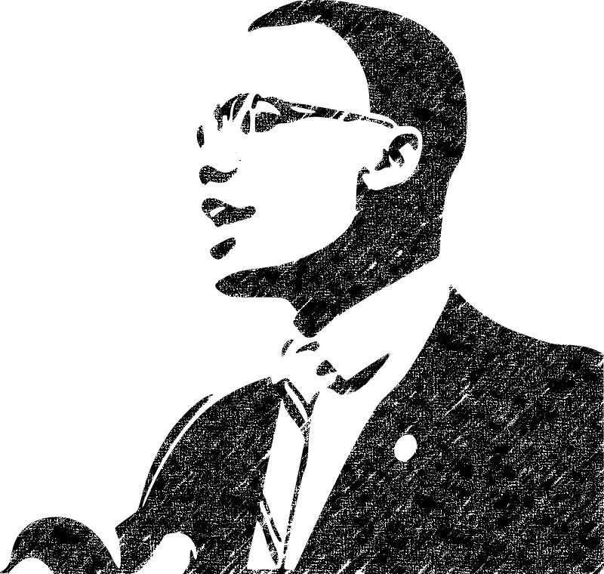
COUNTER IDEOLOGIES
Counter ideologies question the “common-sense” ideas of dominant ideologies and dominant discourses.
They draw attention to how dominant ideologies justify injustice and lead to inequality and discrimination.
“
If you’re not careful, the newspapers will have you hating the people who are being oppressed and loving the people who are doing the oppressing.
– Malcolm X
“
Image by OpenClipart-Vectors from pixabay.com
Notes:
Generally, counter ideologies, and the counter discourses associated with them, articulate an alternative set of values and assumptions that are more inclusive, equitable, just, and less harmful.
“If you’re not careful, the newspapers will have you hating the people who are being oppressed and loving the people who are doing the oppressing.”
– Malcolm X

Slide 28
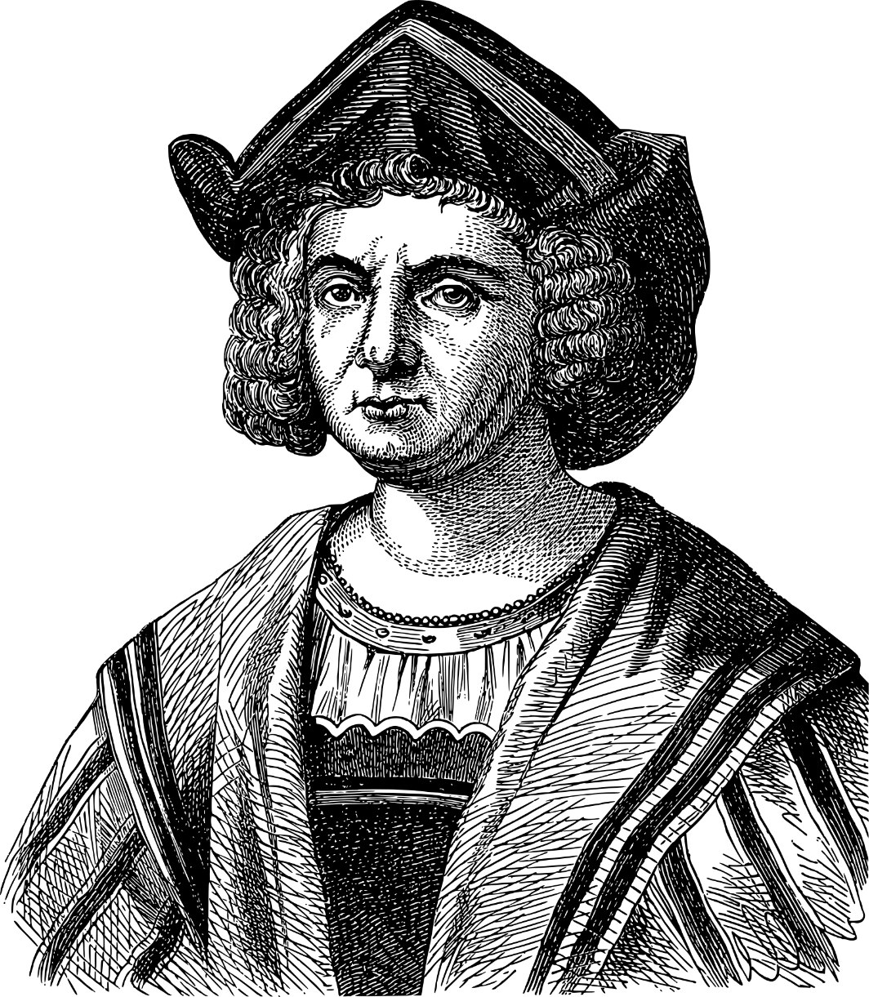
COUNTER IDEOLOGIES
Example…
Many textbooks celebrate the explorer Christopher Columbus as a great hero and credit him with discovering the Americas.
There is a US holiday with his name, Columbus Day.
However, counter ideologies put forward by Indigenous and anti-racist groups point out that Columbus did not discover the Americas; there were people already living here.
Not only that but Columbus murdered and enslaved the Tainos (Indigenous people) he encountered (Bigelow & Peterson, 2003)
Image Gordon Johnson from Pixabay
Notes:
Example - Many textbooks celebrate the explorer Christopher Columbus as a great hero and credit him with discovering the Americas.
There is a US holiday with his name, Columbus Day.
However, counter ideologies put forward by Indigenous and anti-racist groups point out that Columbus did not discover the Americas; there were people already living here.
Not only that but Columbus murdered and enslaved the Tainos (Indigenous people) he encountered (Bigelow & Peterson, 2003)

Slide 29
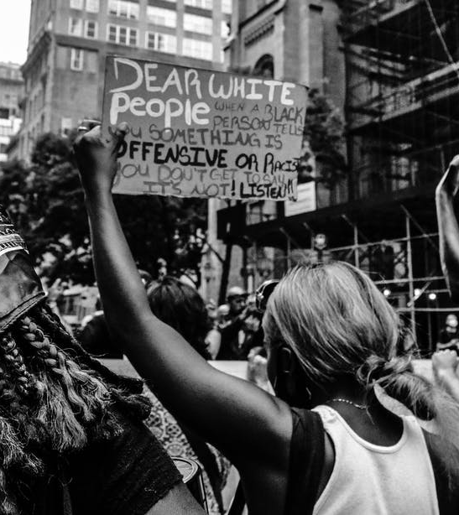
MOVEMENTS
Movements inspired by counter ideologies include …
The Combahee River Collective,
anti-racism,
civil rights,
labour unions,
Occupy Wall Street,
Black Lives Matter,
Idle No More,
Cochabamba, and
The Arab Spring
Photo by Jakayla Toney - Pexels
Notes:
Movements inspired by counter ideologies include …
The Combahee River Collective,
anti-racism,
civil rights,
labour unions,
Occupy Wall Street,
Black Lives Matter,
Idle No More,
Cochabamba, and
The Arab Spring

Slide 30


Notes:
www.Idlenomore.ca 30
Idle No More calls all people to join in a peaceful revolution to honor indigenous sovereignty and protects the land and waters for all peoples.
https://youtu.be/tj9ML5TKeLg

Slide 31

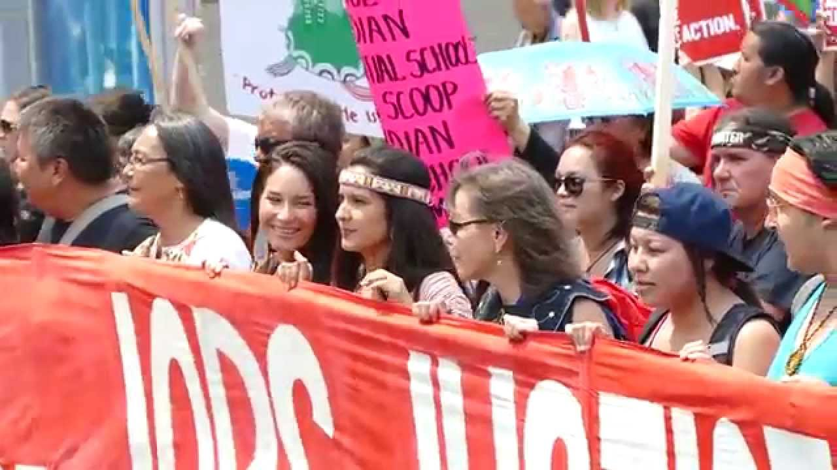
Notes:
https://youtu.be/7bswHch8844
Indigenous Peoples @ The Jobs Justice and Climate March #IdleNoMore

Slide 32
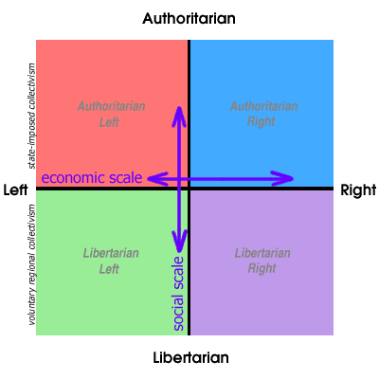
Political compass
What’s your political compass?
Complete the Political Compass Quiz
Determine your primary ideological leaning(s).
https://www.politicalcompass.org/test
Notes:
Complete the Political Compass Quiz to determine your primary ideological leanings https://www.politicalcompass.org/test

Slide 33

BREAK OUT SESSION
Photo By Javiindy.com – Vecteezy.com
Notes:
Potential Break Out Session or Large Group Discussion
Gather into small break out groups
Complete the Political Compass Quiz to determine your primary ideological leanings https://www.politicalcompass.org/test
Discuss your Political compass results in your group

Slide 34
QUESTIONS
Photo by Pixabay from Pexels
Notes:
QUESTIONS

